Slide 1
Plant Seedling Classification
Group D – Data Mining Project
Aakash Pahuja, Adrienne Wang, Murphy Wang, Narasimha Kamath Ardi, Rupa Ghosh, Xintian Su

Slide 2
CO NT ENTS
1. Introduction​
2. Data Exploration​
Basic Statistical Summary​
Unsupervised Clustering
3. Data Preparation​
Data Transformation
4. Methodology​
5. Results and condition​
6. Further Improvements/ Lessons Learnt
7. Reference

Slide 3
/ 01
Introduction
Problem Statement

Slide 4
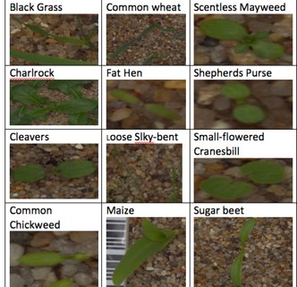
Problem Statement
Objective:
Classify an image of seedling into one of the following 12 different seedling classes.​
Business Use Case:
This information will be used by farmers to plan crop nutrition for higher yields.​
Identifying the exact weed type also helps in applying correct pesticide.
Introduction
Data Exploration
Data Preparation
Methodology
Results
Lessons Learnt

Slide 5
Project Definition of Variables
Train Data ​:
4750 plant seedling images within 12 given species labels. (image size varies)
Test Data​ :
794 plant seedling images with unknown species
Data for Validation:
10% and 30% of train dataset.
20 images for final test
Process Flow
Masking, Segmenting,
Sharpening Images, Normalization
Evaluate Model
on Validation set
……
Data
Pre-Processing
Model Evaluation
Model Training
Prediction
Data Exploration
Train CNN, SVM, InceptionV3,
random forest, XGBoost,
Xception, and VGG19 models
Basic Statistical Summary and Visuals
Run Prediction on Test Set
Introduction
Data Exploration
Data Preparation
Methodology
Results
Lessons Learnt

Slide 6
/ 02
Data Exploration
Basic Statistic Summary
PCA / T-SNE Visualization
Clustering

Slide 7
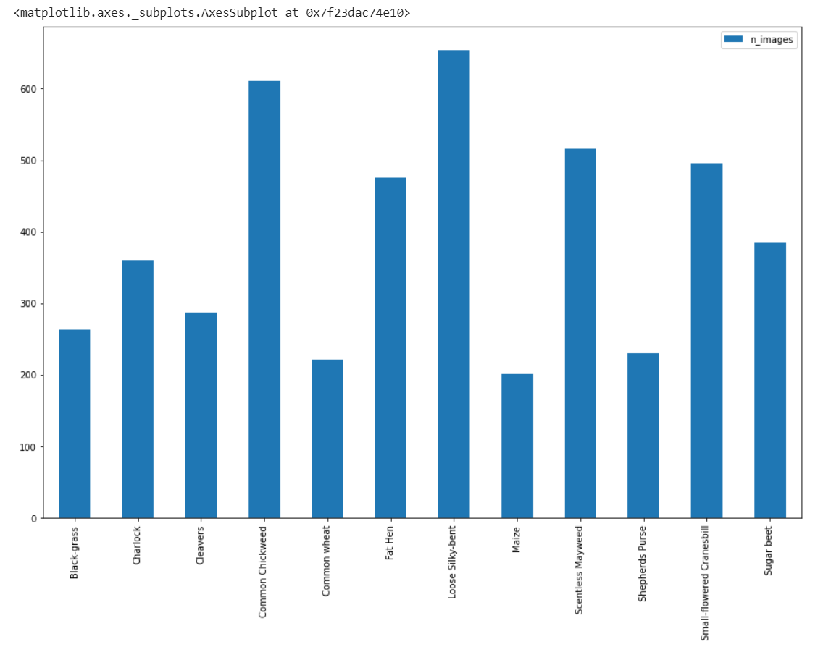
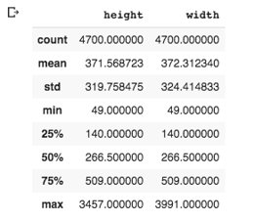
Distribution of the Images Into the 12 Classes
Description of Height And Widths​
Imbalance in the dataset on image sizes and the number of images in each species
Big variation in image size
Introduction
Data Exploration
Data Preparation
Methodology
Results
Lessons Learnt

Slide 8
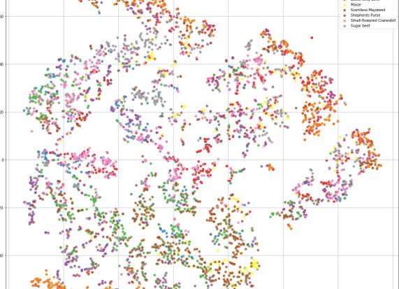
Exploring the Data
Following few slides will cover the exploratory data analysis, tSNE plots to show initial clustering and other unsupervised clustering of the images​
Conclusions- There is no clear delineation of the clusters in this model. We think this is due to very high number of dimensions with this data.
We need to select models that can handle such high number of dimensions.
Introduction
Data Exploration
Data Preparation
Methodology
Results
Lessons Learnt

Slide 9
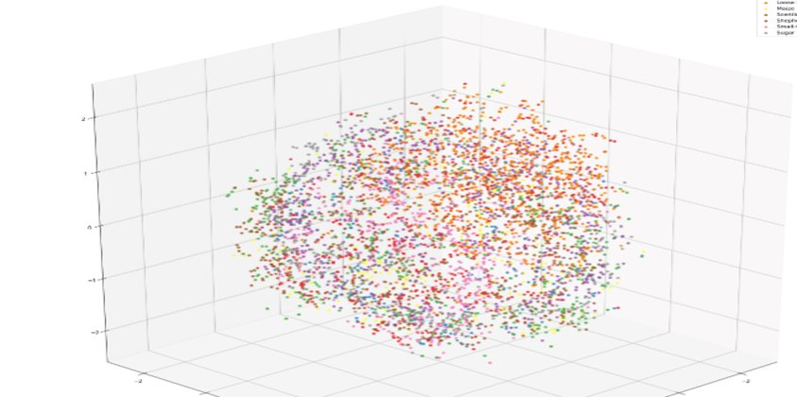
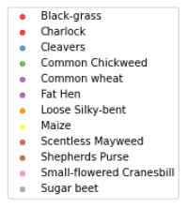
Using 3D T-SNE Plot For Preliminary Clustering​? Still not very conclusive.
Introduction
Data Exploration
Data Preparation
Methodology
Results
Lessons Learnt

Slide 10
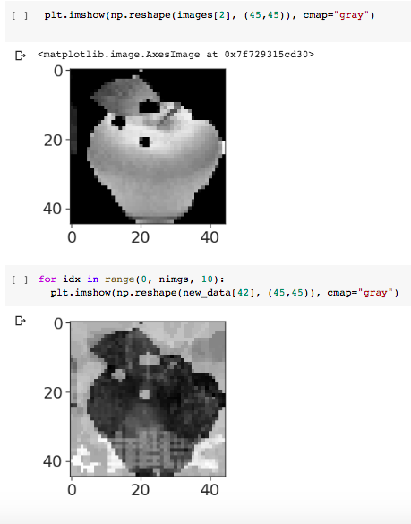
Data Exploration -- Can we create images to balance image categories?
KDE on a sample image
Count of images in the different seedling categories showed that some categories had more images than others.
How can we balance the data in case of images-
One option evaluated was the use of KDE to generate images
We used KDE with kernel=Gaussian and seaborn bandwidth to generate this image.
Conclusion- We chose not to use KDE to create additional images for certain categories due to the models we selected. (Random Forest uses the last layer of CNN to train so imbalanced data won't be problematic)
Introduction
Data Exploration
Data Preparation
Methodology
Results
Lessons Learnt

Slide 11
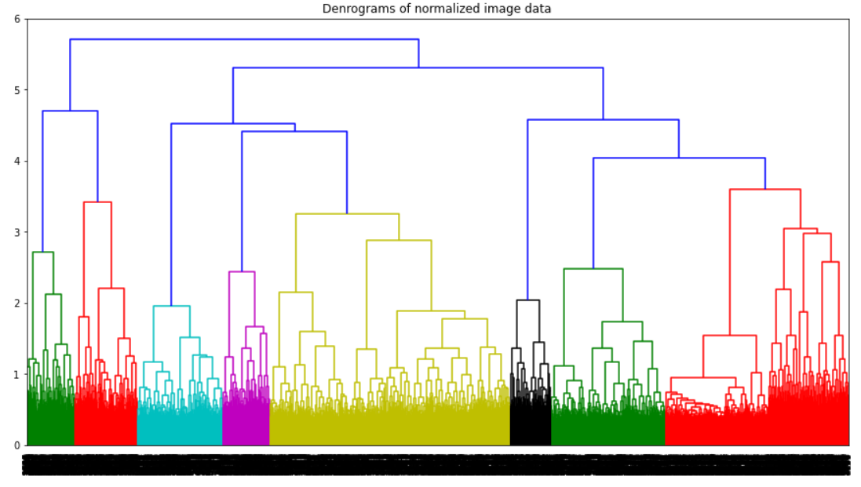
Data Exploration -- Hierarchical Clustering
Original image data after masking and segmenting is transferred into a format of (4700, 16384) numpy array.
Hierarchical Clustering:
8 Groups on train dataset when set the height equals to 4. [ ward’s method (squared error)]
12 Groups on the train dataset if set the height equals to 3.0
Limitation: computational complexity in time and space
Some species are combined together, so should not expect too much out of clustering result
Dendrogram using Ward’s method:
Introduction
Data Exploration
Data Preparation
Methodology
Results
Lessons Learnt

Slide 12
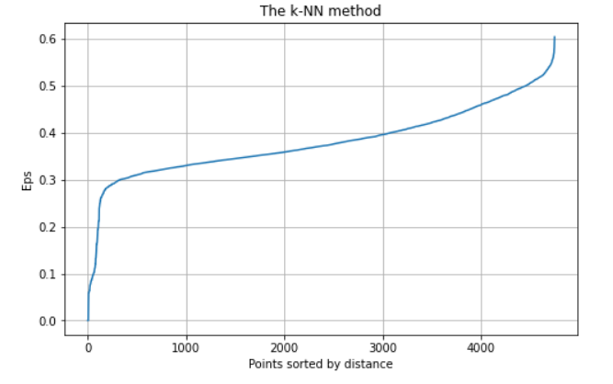
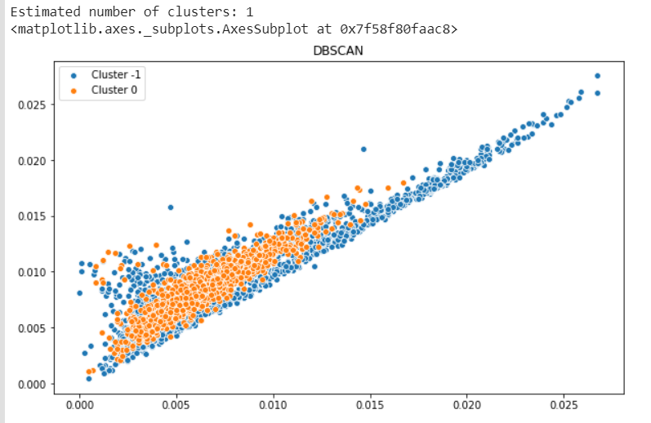
Data Exploration – DBSCAN
K-NN method suggest eps ~ 0.3 - 0.55
Since the dimension (attributes) of the data is too big to visualize, only 2 dimensions are selected to draw.
The number of clusters is always 1 with eps in range of (0.3, 0.55)
Limitations: DBSCAN does not work well on high dimensional data
(Data has 16384 columns as attributes)
Possible Reason: Image size, color intensities, and leave shapes are not consistent after transformation into 2D numerical arrays, may result inaccurate result.
Eps = 0.35, min_samples = 10
Introduction
Data Exploration
Data Preparation
Methodology
Results
Lessons Learnt

Slide 13
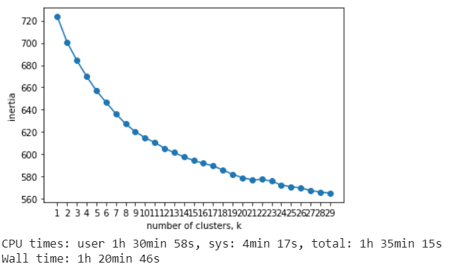
Data Exploration – K-Means Clustering
Using elbow method to select the optimum number of clusters
The inertia plot does not converge to a steady horizontal line when k is in range of 30.
Known species = 12.
K-Mean method is not a good clustering model in this case
All clustering models are applied just to explore our data, and the data is transformed into a (4750 * 16384) matrix
Introduction
Data Exploration
Data Preparation
Methodology
Results
Lessons Learnt

Slide 14
/ 03
Data Preparation
Masking / Segmentation / Sharpening

Slide 15
How did we process Image data? Masking / Segmentation / Sharpening
What is Image Masking? Image masking is the process of revealing relevant portions of the image and hiding unnecessary portions.
The main logic behind masking is to identify the green portion of the image and mask them for both train and test images.
For our project, the leaves of seedling are the portions to be masked. Because, each seedling has different leaves shape, which is a key criterion for our model to distinguish/classify different seedlings.
In addition to masking our images, we also had to resize/standardize our images to a fixed size, as our train and test images were of different sizes and shapes. This step literally helped us to keep our image size consistent. (e.g. Used 45x45 for InceptionV3, 64X64 for Clustering and 256x256x1 for CNN – shape of our processed images)
How did we mask our images?
To achieve this, we utilized OpenCV (Open Source Computer Vision Library).
OpenCV utilizes color detection API's, that identifies pixels in an image that match a specified color or color range (green in our case) which is given as an input by us.
The next slide will demonstrate how we achieved this step utilizing OpenCV API's.
Introduction
Data Exploration
Data Preparation
Methodology
Results
Lessons Learnt

Slide 16
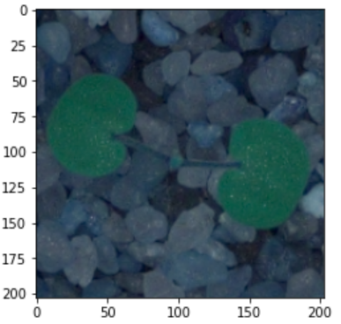
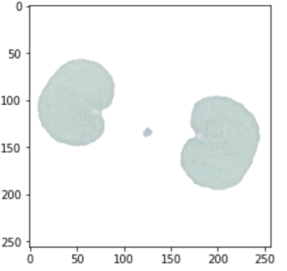
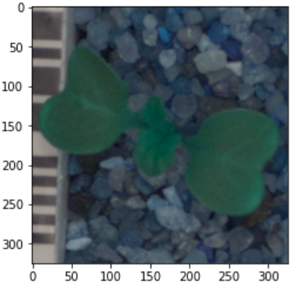
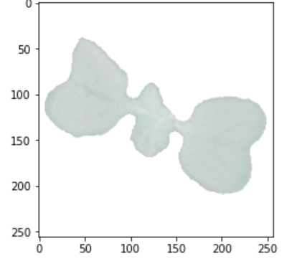
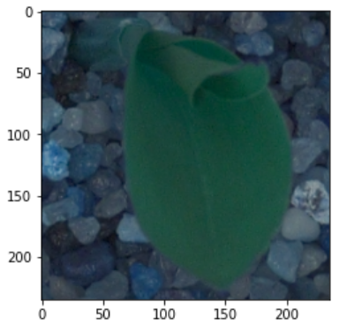
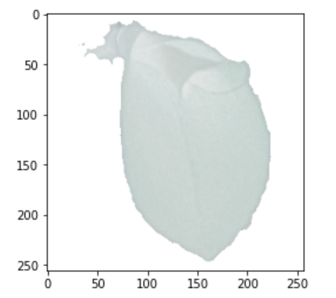
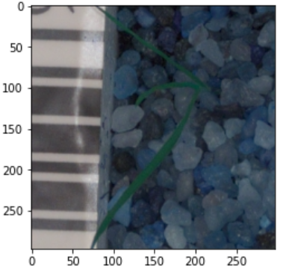
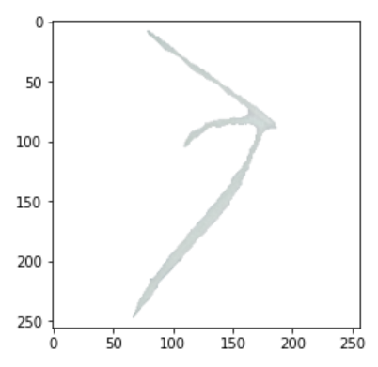
Masking / Segmentation / Preprocessing
Introduction
Data Exploration
Data Preparation
Methodology
Results
Lessons Learnt

Slide 17
/ 04
Methodology
SVM Model
CNN Model
InceptionV3

Slide 18
Methodology
What was our model selection process?​
A variety of Convolutional Neural Networks (InceptionV3, Exception, etc) models are used, as well as supervised learning (Random Forest) classification and GridSearch.
The model with highest precision score is selected eventually to predict the test data.
How did we eliminate bias and over-fitting issues?​
We know that cross fold validation helps address this, but due to computational limitations we did not use this consistently.
What are the different models used and how was each one evaluated?​
All the models we have used were scored on accuracy on the test set of the training data.
Final validation was also done on random pictures downloaded.
What is our strategy for Type1 and Type2 errors handling from this classification?
Type 1 error will occur when we classify an actual crop seedling into a category of a weed and will plan on applying pesticide to destroy.
Type 2 error will occur when we classify a weed as a crop and will leave it as is. The plan would be to accept Type 2 error over Type 1 error.
Introduction
Data Exploration
Data Preparation
Methodology
Results
Lessons Learnt

Slide 19
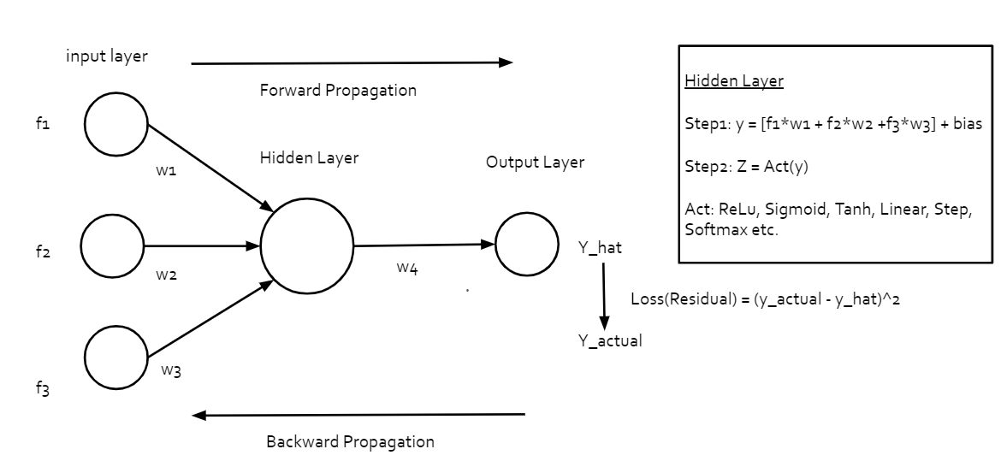
Methodology (A brief introduction to Neural Networks)
Introduction
Data Exploration
Data Preparation
Methodology
Results
Lessons Learnt

Slide 20
Methodology (Regular Neural Nets vs Convolutional Neural Nets)
As discussed in the previous slide, traditional neural networks use a fully-connected architecture, as illustrated below, where every neuron in one layer connects to all the neurons in the next layer.
For an average image with hundreds of pixels and three channels, a traditional neural network will generate millions of parameters, which can lead to overfitting.
Another common problem is that regular NN react differently to an input (images) and its shifted version - they are not translation invariant. For example, if a picture of a cat appears in the top left of the image in one picture and the bottom right of another picture, the regular NN will try to correct itself and assume that a cat will always appear in this section of the image.
Unlike a fully connected neural network, in a Convolutional Neural Network (CNN) the neurons in one layer don’t connect to all the neurons in the next layer. Rather, a convolutional neural network uses a three-dimensional structure, where each set of neurons analyzes a specific region or “feature” of the image.
The concept of Convolutional Neural Networks and its layers will be explained in the upcoming slides.
Introduction
Data Exploration
Data Preparation
Methodology
Results
Lessons Learnt

Slide 21
Convolutional Neural Network (CNN)
CNN is a class of deep neural network that performs similar function as the visual cortex of the human brain. The applications of CNN includes – Image Classification, Image Recognition, Object Detection.
How CNN deals with an image? just like any other machine learning model, CNNs need data in form of numbers in order to learn! With images, these numbers are pixel values.
A CNN has 3 basic layers – convolution layer, pooling layer, Fully connected layer.
In CNN, convolution stands for an operation that is performed on the input image with the help of a filter (filters are learnable weights which learns the features of image pixel by pixel). The outcome of this operation are extracted features called, feature map.
Remember there can be more than one feature maps (An image can have multiple features like eyes, ears, nose etc. When we consider a face image)
Furthermore, the pooling layer handles each of these feature maps individually. It reduces the image resolution but retains the important image features which will be utilized during classification.
Introduction
Data Exploration
Data Preparation
Methodology
Results
Lessons Learnt

Slide 22
Convolutional Neural Network (CNN)
Fully connected layers are an essential component of CNNs, which have been proven very successful in recognizing and classifying images. The CNN process begins with convolution and pooling, breaking down the image into features, and analyzing them independently. The result of this process feeds into a fully connected neural network structure that drives the final classification decision.
What makes CNN to classify images? Activation Functions!!
In layman term AF's basically decide to deactivate neurons or activate them to get the desired output. It also performs a nonlinear transformation on the input to get better results on a complex neural network.
Without nonlinear activation function after each layer, the whole network act as a simple linear transformation, which does not have so much power for complicated task such as image recognition and image classification.
For a classification problem, Sigmoid is a popular activation function. In our problem, we are considering a multi-label classification case and hence we will be utilizing SoftMax.
Introduction
Data Exploration
Data Preparation
Methodology
Results
Lessons Learnt

Slide 23
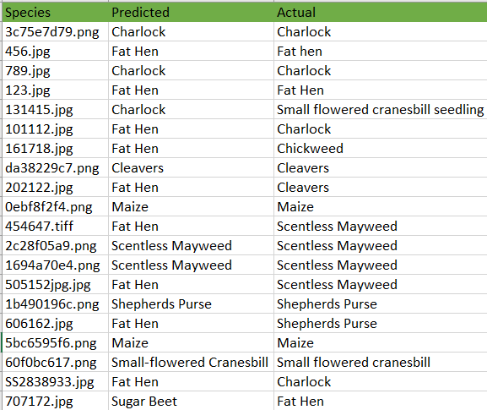
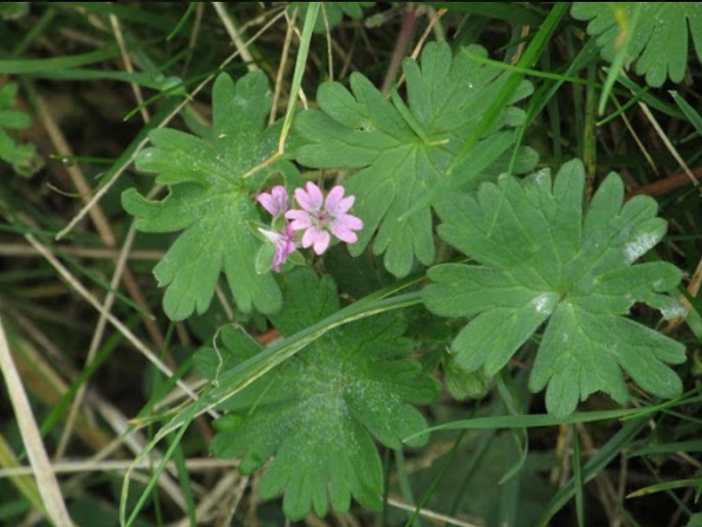
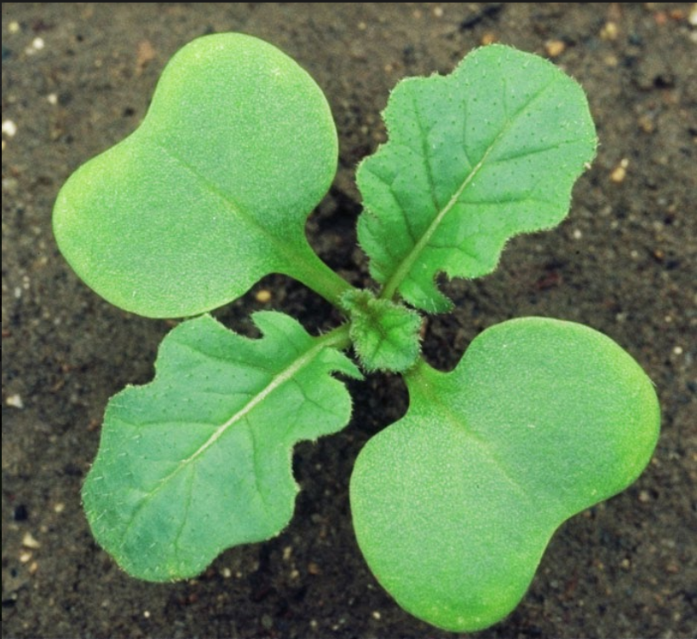
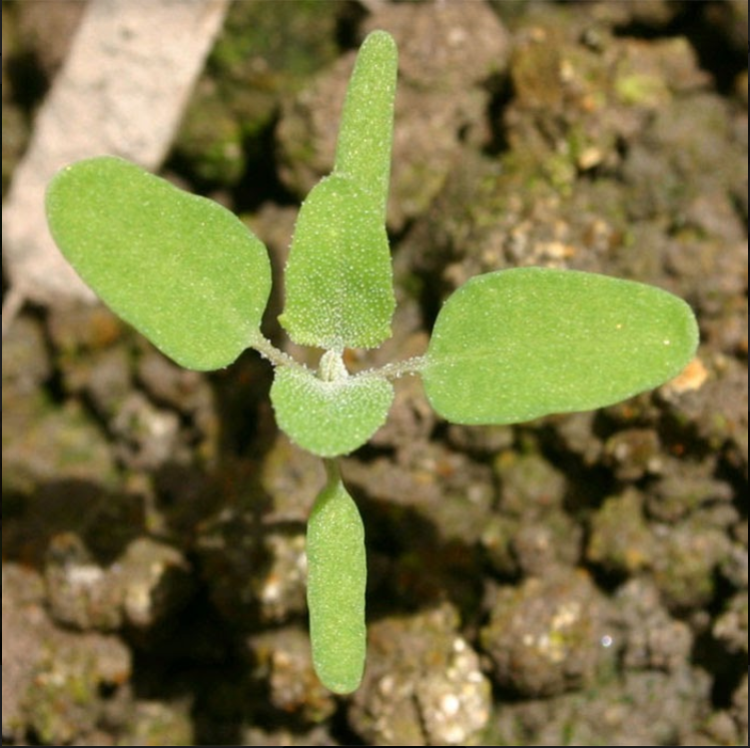
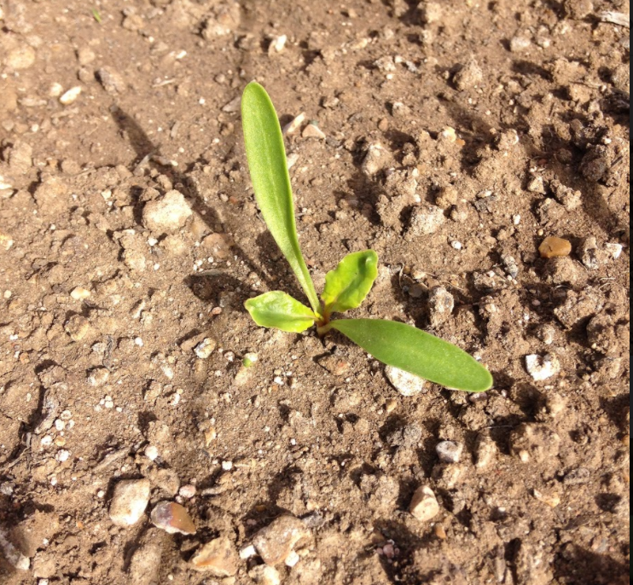
Convolutional Neural Network (CNN)
Accuracy on test dataset: 0.9305
Accuracy on train dataset: 0.9406
Validation dataset: 20 images
No of epochs: 40
Batches per epoch: 32
Introduction
Data Exploration
Data Preparation
Methodology
Results
Lessons Learnt

Slide 24
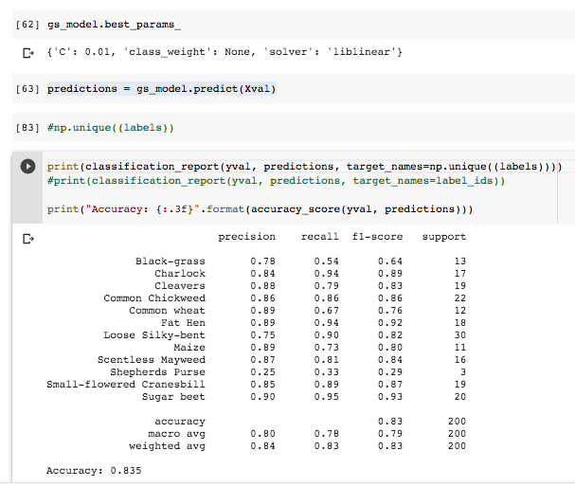
InceptionV3 – a CNN model
Inception-v3 is a convolutional neural network that is 48 layers deep, built on the concept of adding differet sized filters.
Steps:
Input the resized images with labels, extracted features using IncepionV3Model.
Used GridSearch to find the best parameters for the model.
Used the best parameters and used that to predict the test part of the train data.
Accuracy on test dataset: 0.835
Introduction
Data Exploration
Data Preparation
Methodology
Results
Lessons Learnt

Slide 25
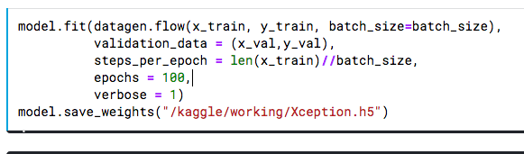
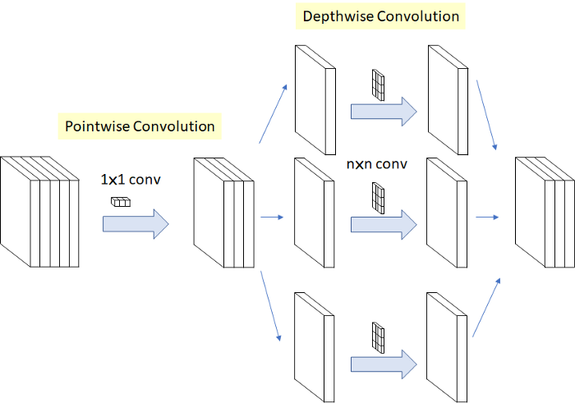
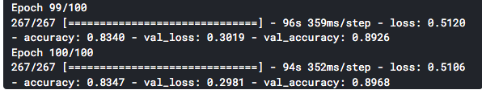
Xception – CNN model
Xception is an extension of the Inception architecture which replaces the standard Inception modules with depthwise separable convolutions. The main difference between InceptionV3 and Xception is Xception complete the Pointwise Convolution(1×1) before Depthwise Convolution(n×n). Usually Xception has higher accuracy than InceptionV3.
Accuracy on test dataset: 0.8968
No. of epochs: 100
Batches per epoch: 16
Introduction
Data Exploration
Data Preparation
Methodology
Results
Lessons Learnt

Slide 26
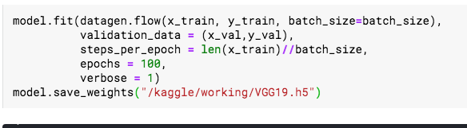
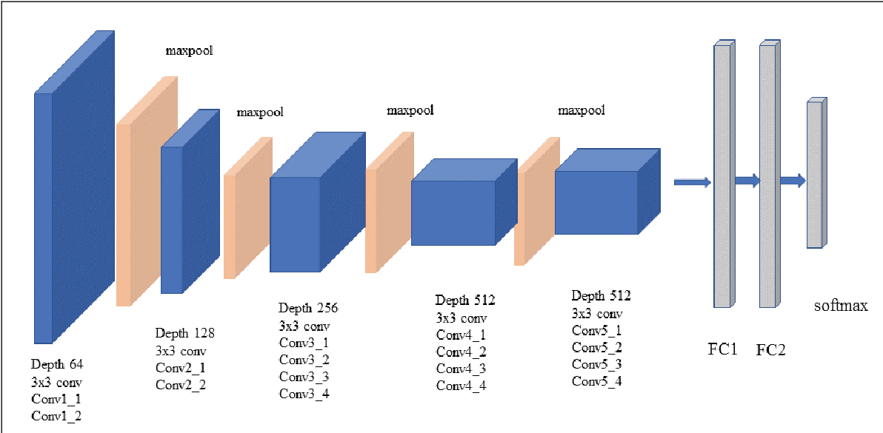
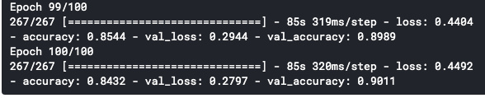
VGG19 – CNN model
The VGG network is characterized by its simplicity, using only 3×3 convolutional layers stacked on top of each other in increasing depth. Reducing volume size is handled by max pooling. Two fully-connected layers, each with 4,096 nodes are then followed by a softmax classifier.
Accuracy on test dataset: 0.9011
No. of epochs: 100
Batches per epoch: 16
Introduction
Data Exploration
Data Preparation
Methodology
Results
Lessons Learnt

Slide 27
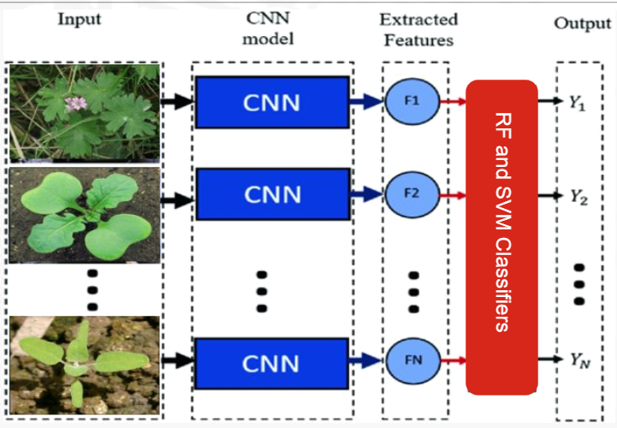
Classification Algorithms.
RF and SVM Classifiers
Introduction
Data Exploration
Data Preparation
Methodology
Results
Lessons Learnt

Slide 28
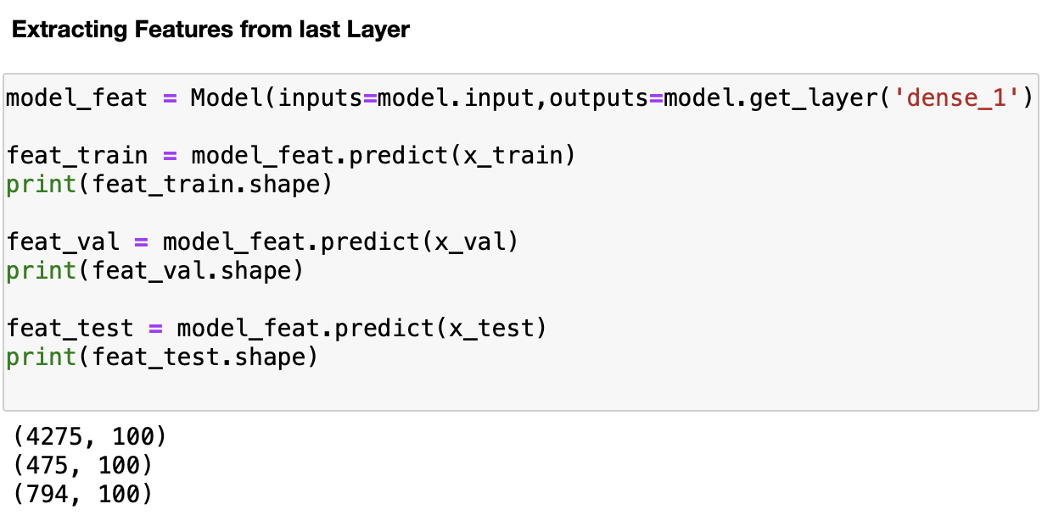
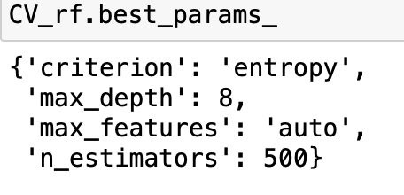
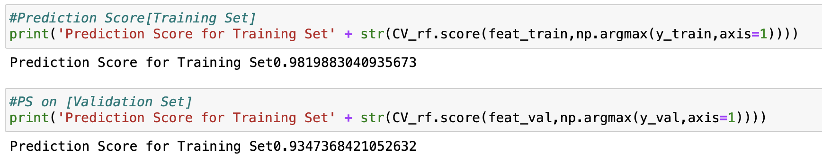
Random Forest Classification Model
CNN Last Layer Extraction
Hyperparameter-tuning(Grid Search)
Model Performance:
RF tends to overfit
Negligible improvements from CNN model
Test
Introduction
Data Exploration
Data Preparation
Methodology
Results
Lessons Learnt

Slide 29
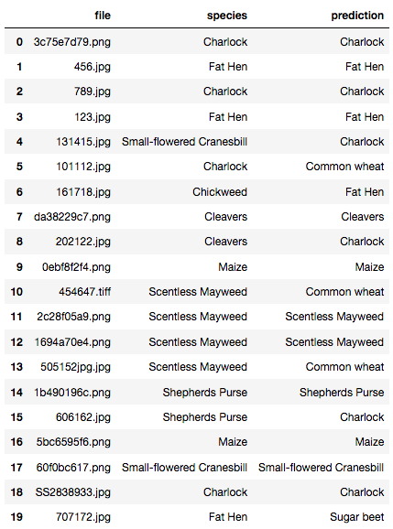
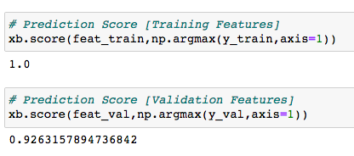
XGBoost Classification Model
XGBoost is a decision-tree-based ensemble Machine Learning algorithm that uses a Gradient Boosting framework. In prediction problems involving unstructured data (images, text, etc.) artificial neural networks tend to outperform all other algorithms or frameworks.
Model Performance:
Accuracy on test dataset: 0.9263
Introduction
Data Exploration
Data Preparation
Methodology
Results
Lessons Learnt

Slide 30
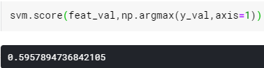
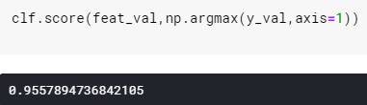
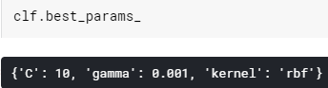
Support Vector Machines (SVM)
Train the Support Vector Classifier without Hyper-parameter Tuning –
First, we trained our model by calling standard SVC() function without doing Hyper-parameter Tuning and the accuracy score we got on our validation data was around 60%.
Train the Support Vector Classifier with Hyper-parameter Tuning –
First, the GridSearchCV ran the same loop with cross-validation, to find the best parameter combination. Once it has the best combination, it runs fit again on all data passed to fit (without cross-validation), to build a single new model using the best parameter setting, which were:
Best Parameters:
Introduction
Data Exploration
Data Preparation
Methodology
Results
Lessons Learnt

Slide 31
Results/ Conditions/ Recommendations
/ 05

Slide 32
Model Comparison
Classification Model | Accuracy Score | Google-generated data (20 images)
CNN | 0.9305 | Predicted 11 images correct
InceptionV3 | 0.835
Xception | 0.8968 | Predicted 5 images correct
VGG19 | 0.9011 | Predicted 6 images correct
SVM | 0.956 | Predicted 10 images correct
Random Forest | 0.935 | Predicted 8 images correct
XGBoost | 0.926 | Predicted 12 images correct
Introduction
Data Exploration
Data Preparation
Methodology
Results
Lessons Learnt

Slide 33
Recommendation
Highest Accuracy Score: SVM
Most Accurate on Google-generated-data: XGBoost
Model Selection: SVM
Model Exploration:
Combine codes together and using the same train and validation data
Increase the number of epochs value for CNN models
Combine different CNN models together (eg. VGG19+Xception)
GridSearch
Try SVM/XGBoost/Random Forest by using the last layer of a more accurate CNN modelimitation
Limitation:
The validation test of Google-generated-data (20 images) did not match the accuracy scores of train dataset. We may have overfitting issue, or the generated data was significantly different from the images in the dataset.
Introduction
Data Exploration
Data Preparation
Methodology
Results
Lessons Learnt

Slide 34
Lessons Learnt
Future Extension
/ 06

Slide 35
Lessons Learnt​
Processing of large data sets and time-consuming models
Needed higher Processing power: We used Kaggle and Google Colab: a great platform for multiple people coding on the same file. But RAM has limitations even for paid users.
Persisting interim steps using Pickle​: Pickle is great tool to serialize and save the trained model for Scikit-Learn models. A pretrained model can be loaded to save time and effort.
Pipelines- Need to use pipelines for consistency. We were not able to complete due to lack of time.
Data Handling and methodology for dealing with images
Data Transformation: Normalization of the image RGB color values from [0..255] to [0..1] will lose some discriminatory features, but the models being computed is much faster.
Concurrent Coding between team members should use the pickle files
We should have persisted the data early on so that each of us did not have to pre-process.
Introduction
Data Exploration
Data Preparation
Methodology
Results
Lessons Learnt

Slide 36
Future extensions of this project
Additional use cases within the model:
Growth of seedlings​: Current images are of very tiny seedlings. We could expand the data set for each of the seedling categories with images of more mature seedlings in different stages.
More variety​: Current scope covers 12 species. Additional species may be added.
Build different models for different geography or seasons.
Expanding the accessibility of this model by making this an application.
Build an application so that multiple organizations can input their images and determine if they are crop or weeds.
Technology to expand with are flask or streamlit.
Introduction
Data Exploration
Data Preparation
Methodology
Results
Lessons Learnt

Slide 37
THA NKS
Aakash Pahuja, Adrienne Wang, Murphy Wang,
Narasimha Kamath Ardi, Rupa Ghosh, Xintian Su

Slide 38
Reference
Data Source: Kaggle https://www.kaggle.com/c/plant-seedlings-classification

Slide 39
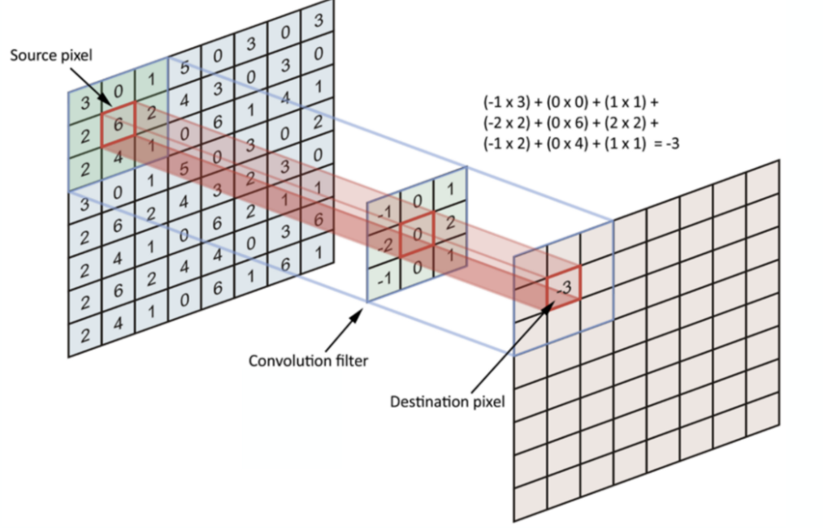
Appendix (A more in-depth information about CNN)
We need three basic components to define a basic convolutional network.
The convolutional layer
The Pooling layer[optional]
The output layer
Convolutional Layer:
In this layer we extract the features from the image.

Slide 40
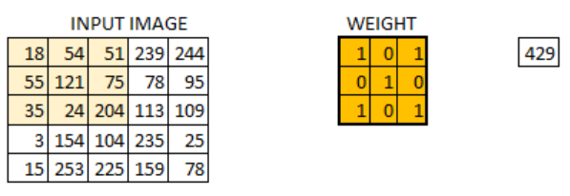
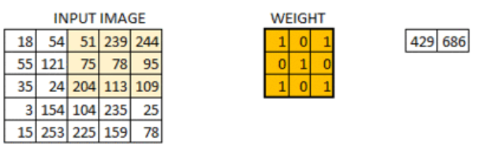
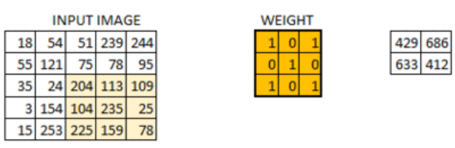
Appendix (A more in-depth information about CNN)
Convolution filter is the weight matrix which run across the image from top-left to bottom-right one-pixel at a time such that all the pixels are covered at least once. Size of the filter can be 3x3 or 5x5 depending upon the use case.
Filter extracts specific information from the original image matrix. For e.g., extracting edges, a particular color or one might blur the unwanted noise.
When weight matrix moves one-pixel at a time it is called Stride 1. If it moves two pixels at a time it is called as Stride 2. Size of convoluted image keeps on reducing as we increase the stride value.

Slide 41
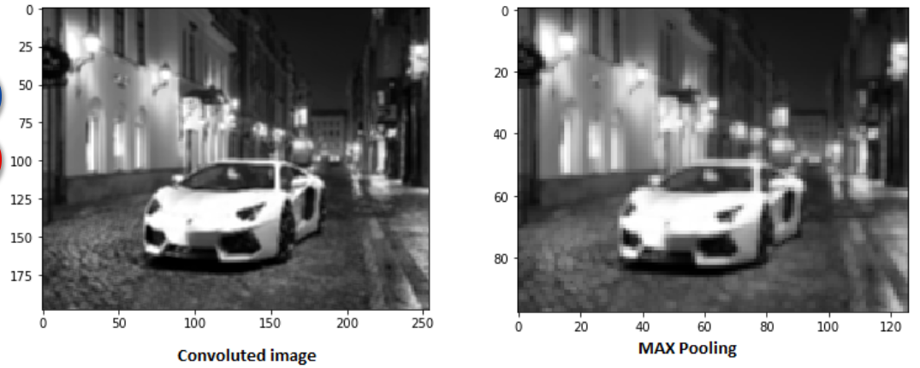
Appendix (A more in-depth information about CNN)
Pooling Layer:
Pooling layer reduces the number of trainable parameters, when the images are too large, we use pooling to reduce the spatial size of the image.
The most common form of pooling layer generally applied is max pooling.

Slide 42
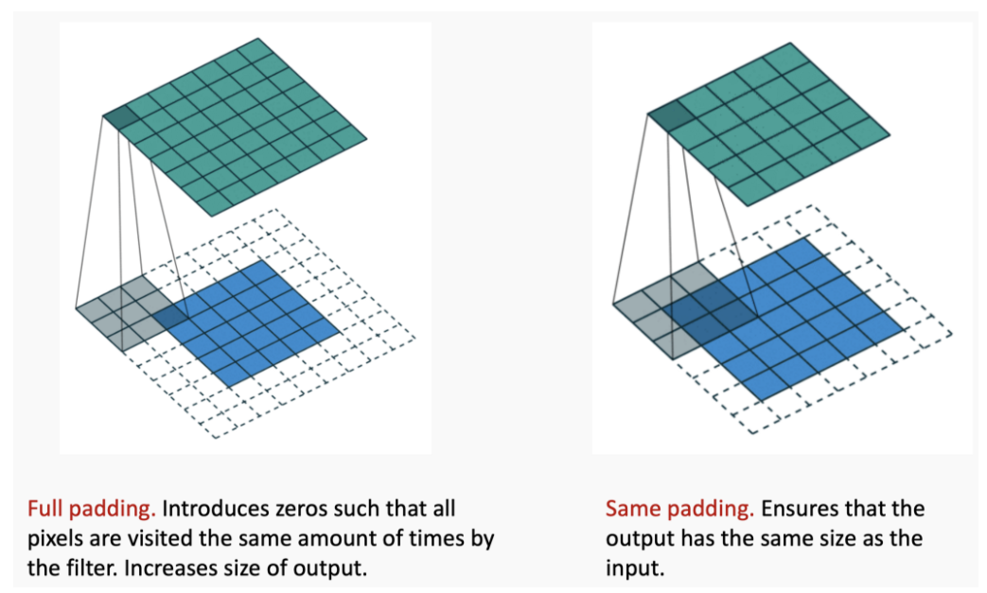
Appendix (A more in-depth information about CNN)
Padding:
Output of the convolution layer down-sample the size of the image. In order to keep the size of the output similar to the Input image we apply padding with zeros.

Slide 43
Appendix (A more in-depth information about CNN)
Activation Functions:
Now we know the basic architecture of CNN, let’s now dive into activation function, which performs non-linear transformations on the neural network, to learn and perform more complex tasks.
In our CNN architecture, we have used two popular activation functions: ReLu & Softmax.
ReLu & Softmax are also called the general-purpose activation functions, that are used in most of the CNN architectures.
Let’s now understand how these activation functions helps our network to learn better in an efficient way.
The ReLu activation function is represented by a equation A(x) = max(0,x). This implies that the output is x, if x is positive or 0 if x is negative.
First of all, ReLu is nonlinear in nature. And combinations of ReLu are also nonlinear! ( in fact it is a good approximator. Any function can be approximated with combinations of ReLu). Great, so this means we can stack layers. It is not bound though. The range of ReLu is [0, inf].

Slide 44
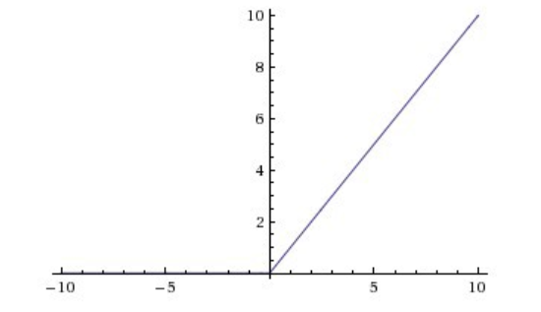
Appendix (A more in-depth information about CNN)
Another major property of ReLu activation is that its activations are not dense as compared to sigmoid and tanh functions. Let’s consider a huge neural network with lots of neurons. ReLu only activates few neurons to describe the output, which makes it lighter and computationally less expensive than the other activation functions.

Slide 45
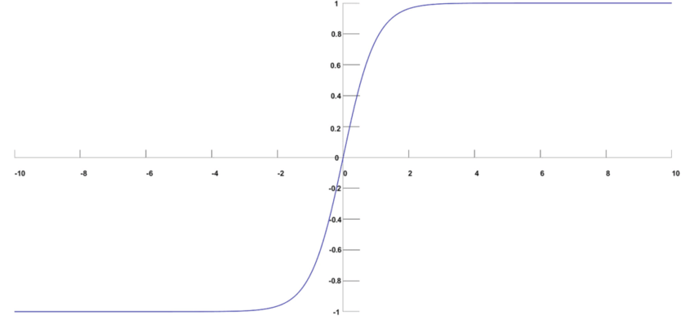
Appendix (A more in-depth information about CNN)
On the other hand, SoftMax activation is very similar to the sigmoid activation. It is most popularly called the multinomial logistic regression as well.

Slide 46
Appendix (A more in-depth information about CNN)
The way neural networks learn is through back-propagation. But, at what learning rate it should learn so that the loss is minimum ?
That is why we have so many optimizers, which adjusts the weights of neural networks, so that the loss is not unbearably high.
We have utilized Adam (Adaptive Moment Estimation) optimizer for our model.
There are various other optimizers such as Gradient Descent, Stochastic Gradient Descent, AdaGrad etc.
Despite these optimizers, Adam is almost used in most of the CNN models today while training as it is efficient and consumes less memory.
However, Adam can be computationally expensive when compared with other optimizers.

Slide 47
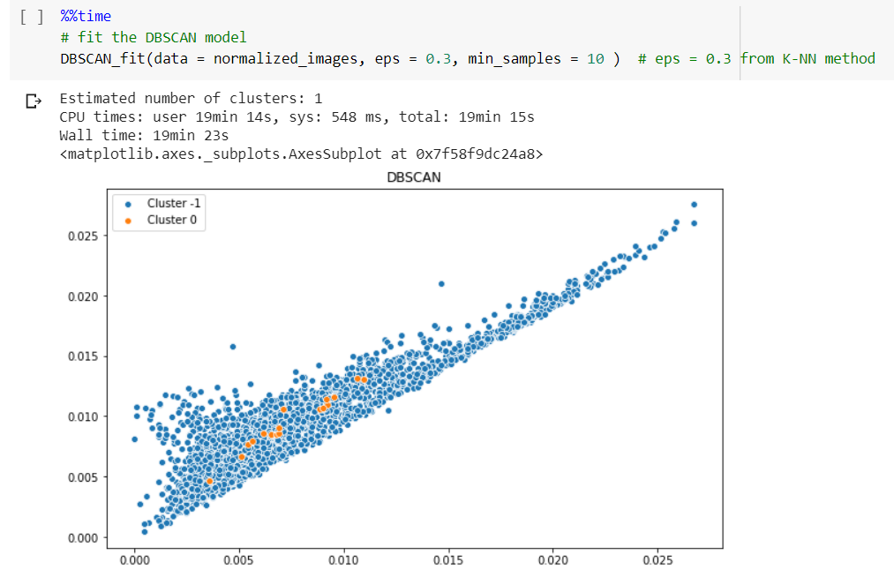
DBSCAN Model with eps = 0.3 on Train Data
Only 2 out of 16500 columns are selected to make the plot

Slide 48

DBSCAN Model with eps = 0.4 on Train Data
Only 2 out of 16500 columns are selected to make the plot

Slide 49

DBSCAN Model with eps = 0.4 on Train Data
Only 2 out of 16500 columns are selected to make the plot

Slide 50

Hierarchical Clustering on Test Dataset ( 794 images)
Using linage method "ward"

Slide 51

Hierarchical Clustering on Train Dataset ("Average" Linkage)

